Slide 1
Time Series Unit 7
Forecasting

Slide 2
Break Out 1

Slide 3

ACF of (1-B)X_{t} = a_{t}
a = gen.aruma.wge(5000,d = 1, vara = 1, sn = 6)
plotts.sample.wge(a)
plot(a[1:4999],a[2:5000], xlab = "X_t-1", ylab = "X_t", main = "Plot of X_t vs. X_t-1")
cor(a[1:4999],a[2:5000])

Slide 4

ACF of (1-B⁴)X_{t} = a_{t}
a = gen.aruma.wge(5000,s = 4,vara = 100, sn = 6)
plotts.sample.wge(a)
plot(a[1:4996],a[5:5000], xlab = "X_t-4", ylab = "X_t", main = "Plot of X_t vs. X_t-4")
cor(a[1:4996],a[5:5000])

Slide 5
ACF of (1-B¹²)X_{t} = a_{t}
Reproduce the same analysis as on the last 3 slides for the s = 12 model above.
Compare the linear correlation between X_{t} and X_{t-12} to from the acf.
Compare the linear correlation between X_{t} and X_{t-13} to from the acf.

Slide 6
End Break Out 1

Slide 7
Break Out 2

Slide 8
Question:
Assume you have data that is recorded monthly that you think could be appropriately modeled with an ARIMA(0,0,0) and s = 4.
What would be the mathematical form of the model?
Describe what the model is saying about the data … about the correlation.

Slide 9
End Break Out 2

Slide 10
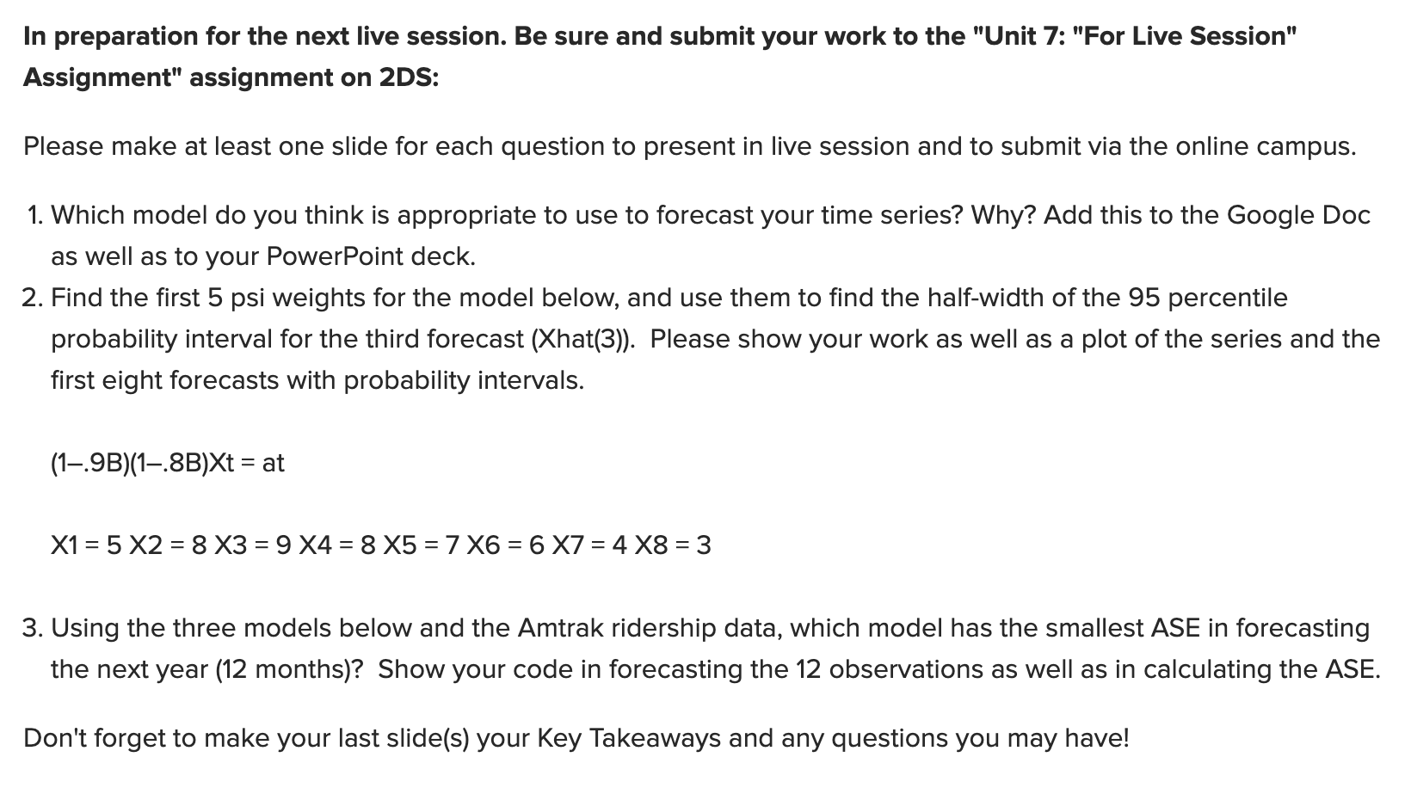
For Live Session Assignment

Slide 11
Break Out 3

Slide 12
Review and Describe Your Realization
Remind your group about your realization
Topic
Scale
ACF / Spectral Density
Describe which model structure you speculate would be appropriate and/or not appropriate for your realization.
Ask any questions you might have about your or anyone else’s realization / model choice in your group.

Slide 13
End Break Out 3

Slide 14
Break Out 4

Slide 15
Cover Question 2
Cover ARMA(p,0)
Show example / solution … maybe snap shot of marker board derivation.

Slide 16
End Break Out 4

Slide 17
Break Out 5

Slide 18
Amtrak: For Live Session Question 3
Using the three models below and the Amtrak ridership data, which model has the smallest ASE in forecasting the next year (12 months)? Show your code in forecasting the 12 observations as well as in calculating the ASE.
MODEL 1:
phis: c(0.5511, 0.1680, -0.0145, 0.0651, 0.1388, -0.2966, 0.1539, 0.1270, -0.1815, 0.0364, 0.1456, 0.6287, -0.3832, -0.0199, -0.1679)
phis: c(-0.02709541, 0.74213105)
thetas: c(-0.5844596, 0.3836931)
phi: 0.306943
theta: 0.7431719

Slide 19
End Break Out 5

